Slide 1

Software Architecture Design
Project's name:
Hospital Management system
Group members:
Aliza Yasin –F2024065281
Hadiya Malik--F2024065269

Slide 2

Project's Scope
Scope of Hospital Management System(HMS) is:
Patient registration
Doctor management
Appointment Scheduling
Billing System
Room and ward management
Pharmacy

Slide 3

Software architecture
Definition: It is the structure of a software system.
Purpose: It defines how different parts of the software are organized.
Function: It explains how different components link and work together.
Goal: To make the system stable, secure, and easy to manage.
In HMS it will show how different parts (Doctor, Patient, Billing modules) connect with each other.

Slide 4

Types of Architecture styles
Layered Architecture
Client-Server Architecture
Microservices Architecture
Event-Driven Architecture
MVC (Model-View-Controller)
SOA (Service-Oriented Architecture)
Peer-to-Peer (P2P) Architecture
Pipe-and-Filter Architecture
Broker Architecture
Component-Based Architecture

Slide 5
Selected Style: Layered Architecture
Presentation Layer
  What it does: Shows information to users (doctors, staff, patients)
  Examples: Patient registration screens, appointment booking UI, dashboard
Business Logic Layer (or Application Layer)
  What it does: Handles all the rules and operations of the system
  Examples: Scheduling appointments, calculating bills, managing doctor availability
Data Layer (or Database Layer)
  What it does: Stores and manages all the hospital data
  Examples: Patient records, billing info, pharmacy inventory

Slide 6
Why Layered Architecture?
Benefits:
Separation of Concerns: Each layer does its own job (UI shows info, logic schedules, data stores records)
Easy Maintenance: Fix or update one part without affecting others
Scalable: Can add new features or improve existing modules later
Testable & Reusable: Can test parts separately; some parts can be used again
Security: Security controls can be applied to each layer,preventing unauthorized access to sensitive data

Slide 7

Why not other styles?
Client-Server Architecture
Microservices Architecture
Only handles server-client communication.
HMS needs organized internal layers, not just client-server.
Splits system into many small services.
For HMS, managing many services is complex and unnecessary.

Slide 8
Event-Driven Architecture
Best for real-time, continuous events (like stock updates or sensors).
HMS mainly has appointments, billing, and records.
No constant events that need instant reactions.
MVC (Model-View-Controller)
Only structures the user interface.
Cannot organize the full hospital system.
Does not separate business logic or data management

Slide 9
Service-Oriented Architecture(SOA)
Requires extra messaging between services.
Adds overhead that HMS doesn’t need.
Centralized hospital system works efficiently without it.
Peer-to-Peer (P2P)
Decentralized system with no central database.
HMS needs central storage for patient records and billing.
Hard to maintain consistency across hospital modules.

Slide 10
Pipe& Filter
Broker
Designed for continuous data processing.
HMS mostly performs CRUD operations.
Not suitable for appointments, billing, and patient management.
Uses middleware to manage distributed modules.
HMS modules don’t require broker communication.
Centralized control is simpler and more efficient.

Slide 11
Component based
  Focuses on reusable components only.
  Hospital management system needs a clear layered structure for different hospital functions.
  Components alone won’t organize the system effectively.
  Final verdict
Layered Architecture is the most suitable choice for our Hospital Management System because it is organized, secure, and easy to manage.
Functional Alignment: It successfully supports all our core modules like Patient Registration, Appointment Scheduling, and Billing by organizing them into specific layers.
Project Goals: This structure ensures the system is stable, secure, and easy to manage, which were our primary goals.
Future Scalability: This architecture makes it very easy to add a Mobile App or an AI-based module in the future without rebuilding the whole system.
Thankyou

Slide 12
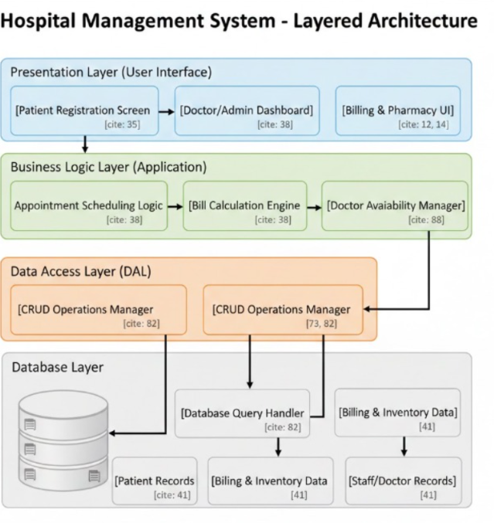

Slide 13
Thankyou

